Slide 1

Autonomous Exploration System for Volcanic Terrain Using MDP
Group 05
Team Members:
Syeed Mahmud 2211486042
Amrita Biswas 2022015642
Md Esak Ali 1921789042
Fatema Rahman Lamia 2021996642

Slide 2
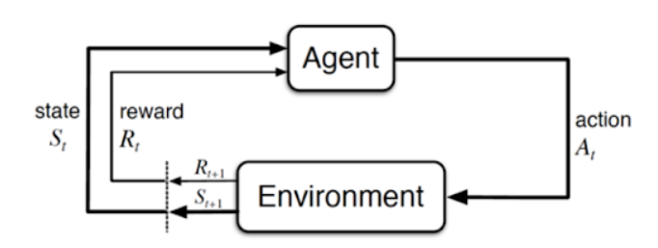

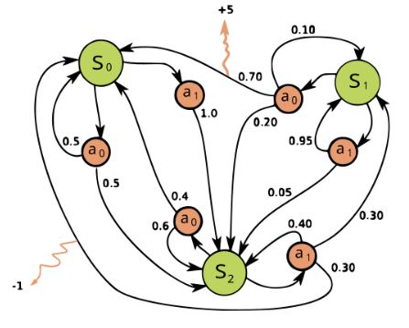
What Is Markov Decision Process (MDP)
MDP : 4 Key Element (S, A, Pa, Ra)
State (S)
Action (A)
Transition Probabilities (Pa)
Reward (Ra)
Earning Point
Policy
Value Function State-value function ( v)
Action-value Function (q)

Slide 3
Problem Statement:
Design an autonomous exploration system using Markov Decision Process (MDP) for navigating through a simulated volcanic terrain while effectively managing uncertain environmental conditions, such as lava flows, caters, gas emission, etc. The objective is to maximize the efficiency of exploration while ensuring the safety of the exploration agent.
Objective
Design an autonomous agent that can safely explore volcanic terrain to reach a goal position while avoiding hazards such as lava flows, gas emissions, and craters.
MDP Justification
Sequential Decisions: Multi-step path planning required
Uncertainty: Unpredictable volcanic environment
Optimization: Balance between safety and efficiency
Mathematical Framework: Formal analysis and solution methods

Slide 4
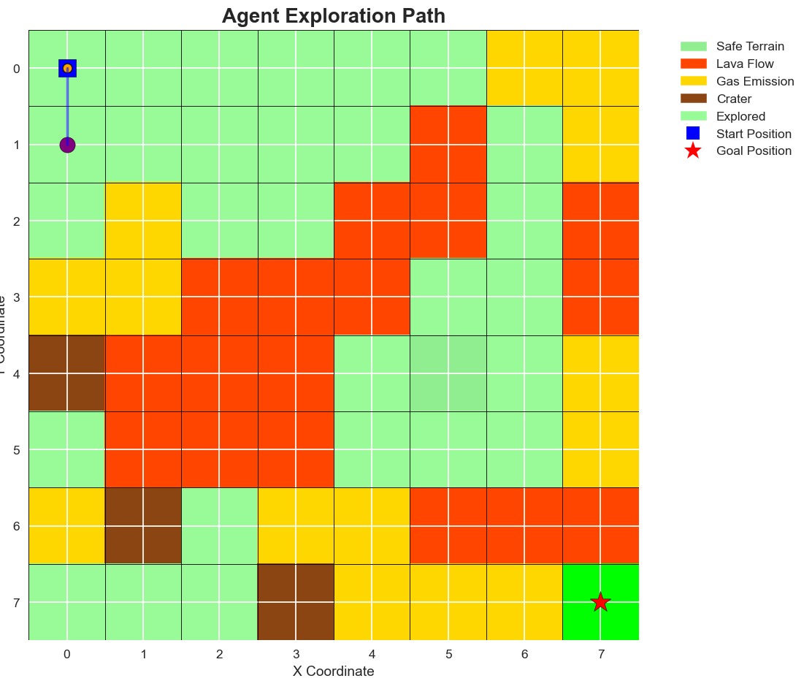
1. State Space (S)
Definition: Set of all possible agent positions in the terrain grid
Mathematical Representation: S = {(x,y) | 0 ≤ x < grid_size, 0 ≤ y < grid_size} |S| = grid_size²
Implementation: - Grid-based discrete state space - Each state represents agent's (x,y) coordinate - For 5×5 grid: 25 total states - States include both safe and hazardous positions
Example States: - (0,0): Start position (top-left) - (4,4): Goal position (bottom-right) - (2,3): Intermediate exploration position

Slide 5
2. Action Space (A)
Definition: Set of available movement actions
Mathematical Representation: A = {NORTH, SOUTH, EAST, WEST} |A| = 4
Action Effects: - NORTH: (x,y) → (x-1,y) [move up] - SOUTH: (x,y) → (x+1,y) [move down] - EAST: (x,y) → (x,y+1) [move right] - WEST: (x,y) → (x,y-1) [move left]
3. Transition Function T(s'|s,a)
Definition: Probability of reaching state s' from state s by taking action a
Mathematical Representation: T(s'|s,a) = P(s_{t+1} = s' | s_t = s, a_t = a)
Implementation: - Type: Deterministic transitions - Value: T(s'|s,a) = 1 for valid transitions, 0 otherwise - Boundary Handling: Agent remains in current state if action leads outside grid
Example Transitions: - T((1,0)|(0,0),SOUTH) = 1.0 - T((0,1)|(0,0),EAST) = 1.0 - T((0,0)|(0,0),NORTH) = 1.0 [boundary case]

Slide 6
4. Reward Function R(s,a,s')
Definition: Immediate reward received for transitioning from s to s' via action a
Mathematical Representation: R(s,a,s') = reward based on terrain type at s'
Reward Structure: R(s,a,s') = { +100 if s' is goal state -1 if s' is safe terrain -50 if s' is gas emission -75 if s' is crater -100 if s' is lava flow }
Design Rationale: - Positive Goal Reward: Encourages mission completion - Movement Cost: Promotes efficient paths - Hazard Penalties: Enforces safety constraints - Scaled Penalties: Different hazard severity levels
5. Discount Factor (γ)
Definition: Weight given to future rewards
Value: γ = 0.9
Mathematical Effect: Total Return = Σ(t=0 to ∞) γᵗ × R(s_t, a_t, s_{t+1}) Purpose: Balance immediate vs. long-term rewards

Slide 7
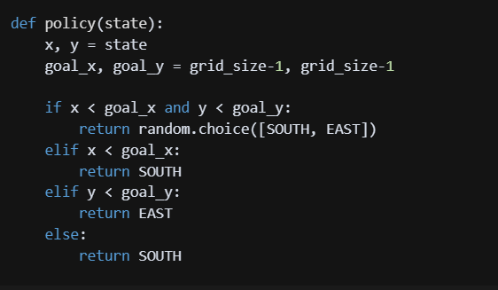
Heuristic Policy Implementation
Strategy: Move towards goal while considering terrain
Policy Definition
Policy π(a|s)
Definition: Function mapping states to actions
Mathematical Representation: π: S → A π(s) = action to take in state s
Properties:
Deterministic: Each state maps to exactly one action
Goal-Oriented: Generally moves toward target
Simple: Easy to understand and implement
Suboptimal: Does not consider hazards in path planning

Slide 8
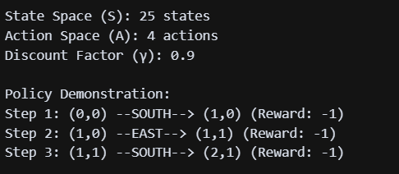
Current Results
System Demonstration
Test Execution:
Grid Size: 5×5 (25 states)
Actions: 4 directional movements
Policy: Heuristic goal-seeking
Transitions: Deterministic
Sample Output

Slide 9
Future Work:
Phase 1: Algorithm Implementation
Value Iteration: Compute optimal value function V*(s)
Policy Iteration: Find optimal policy π*(s)
Q-Learning: Model-free learning algorithm
Phase 2: Model Enhancements
Stochastic Transitions: Add movement uncertainty
Dynamic Environment: Changing hazard locations
Extended State Space: Include agent orientation/energy

Slide 10
Conclusion
Achievements
In todays update successfully establishes a complete MDP formulation for volcanic terrain exploration:
Mathematical Foundation: Formal MDP tuple (S,A,T,R,γ) defined
Implementation: Working code demonstrating all components
Policy Framework: Initial heuristic policy implemented
Verification: System tested and validated
Significance
This work provides:
Theoretical Basis: Rigorous mathematical framework
Practical Foundation: Implementable system architecture
Extensible Design: Ready for algorithm development
Educational Value: Clear demonstration of MDP concepts

Slide 11
Thank You

